Slide 1
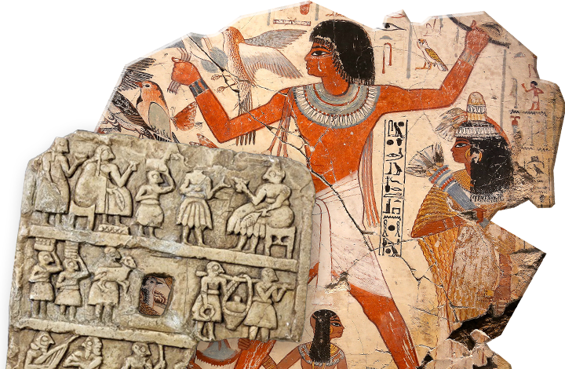
Investigating Ancient Civilisations
Goal/s:
Describe the ‘out of Africa’ theory
Analyse sources from ancient civilisations
Week 10 Lesson 1
Ms Barrie

Slide 2
Class Discussion
What ancient civilisations do you know about?
What do you know about them?

Slide 3
Modern humans existed on Earth for about 200,000 years. Archaeologists and scientists have gathered primary sources, such as bones and early tools, to uncover evidence about early humans, and to generate theories about how they spread across the Earth.
The earliest remains of people that are anatomically like humans (Homo sapiens) were found in East Africa. From there, historians believe they spread to other parts of Africa. Ancient peoples were mostly nomadic, meaning they moved around a lot in search of food and shelter.
Read through the following

Slide 4
It is believed that approximately 100,000 years ago, these first humans left Africa and arrived in the Middle East. Over thousands of years, many waves of migrating groups of humans left Africa, travelling in different directions and living nomadic lifestyles.
Evidence of agriculture dating back to that time was discovered in the Middle East, which proved that humans were able to at one point – settle in one place. From then on, humans started to develop increasingly complex societies and civilizations.
Read through the following

Slide 5
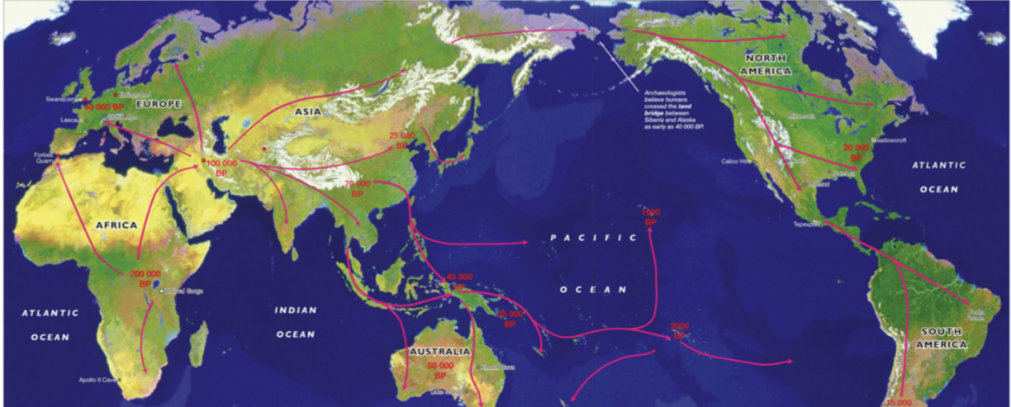
The source above shows the spread of humans from their beginnings in East Africa to other parts of the world. This spread of humans across the world from origins in Africa is known as the ‘Out of Africa’ theory. Some scholars argue that early humans developed simultaneously in different parts of the world. However, fossil and genetic evidence strongly supports the ‘Out of Africa’ Theory.

Slide 6
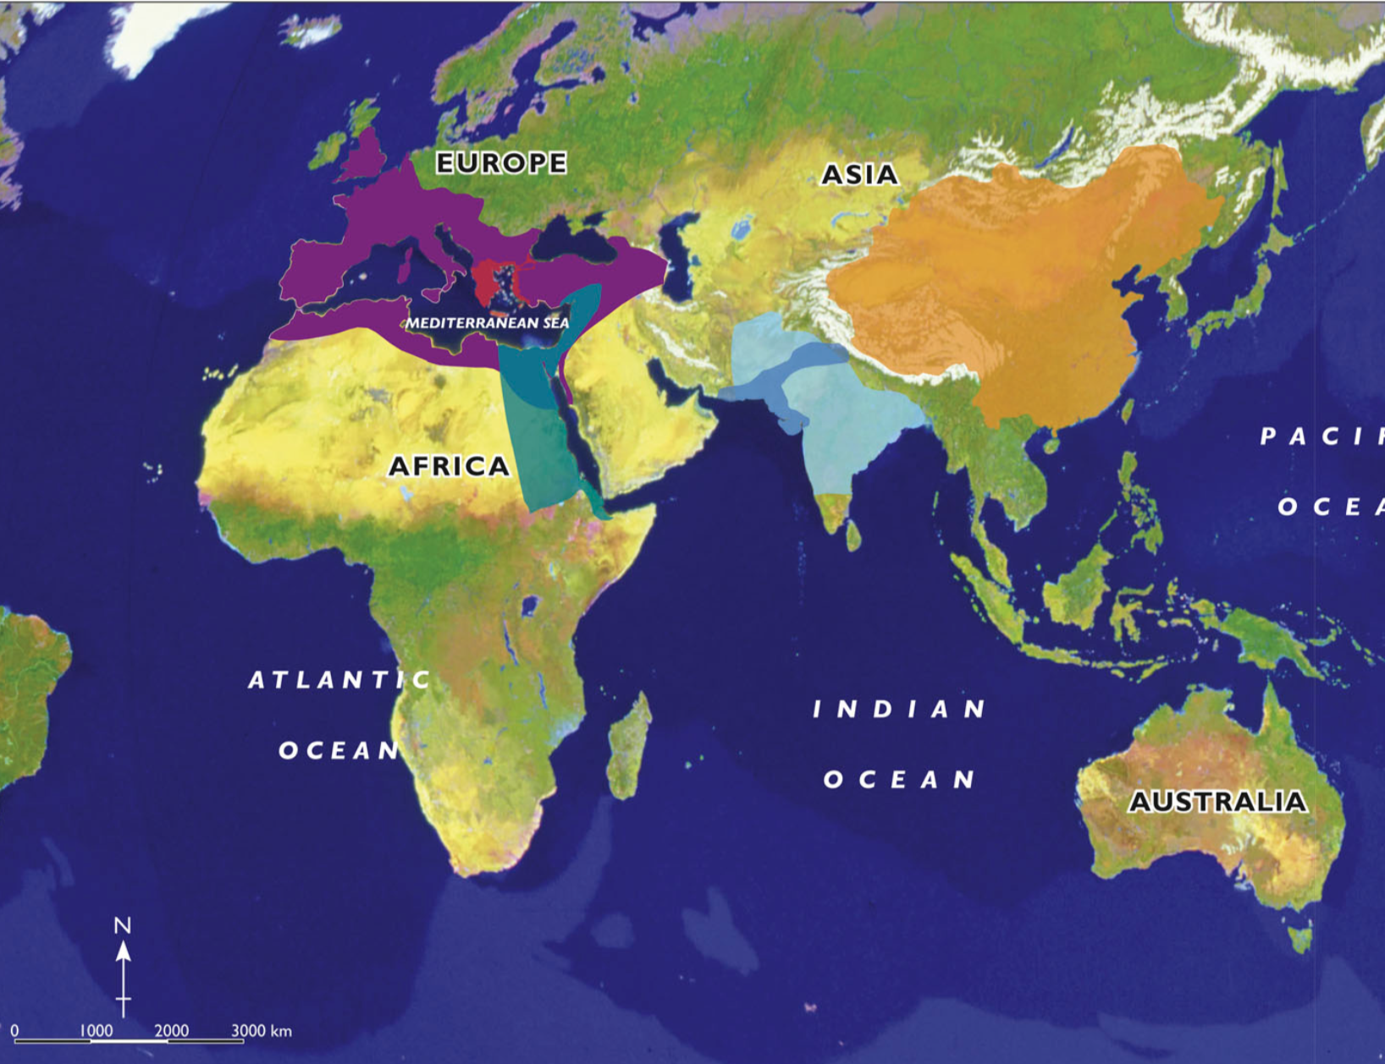
Ancient Civilisations
Some of the most important Ancient civilisations developed around the continents.
Write key words about each and their dates

Slide 7
Ancient Greece
C. 776 – 146 BCE
Modern day Greece and Turkey, Mediterranean and Black Dea
Only lasted about 400 years but had a lasting legacy (e.g. democracy) on the Western World today

Slide 8
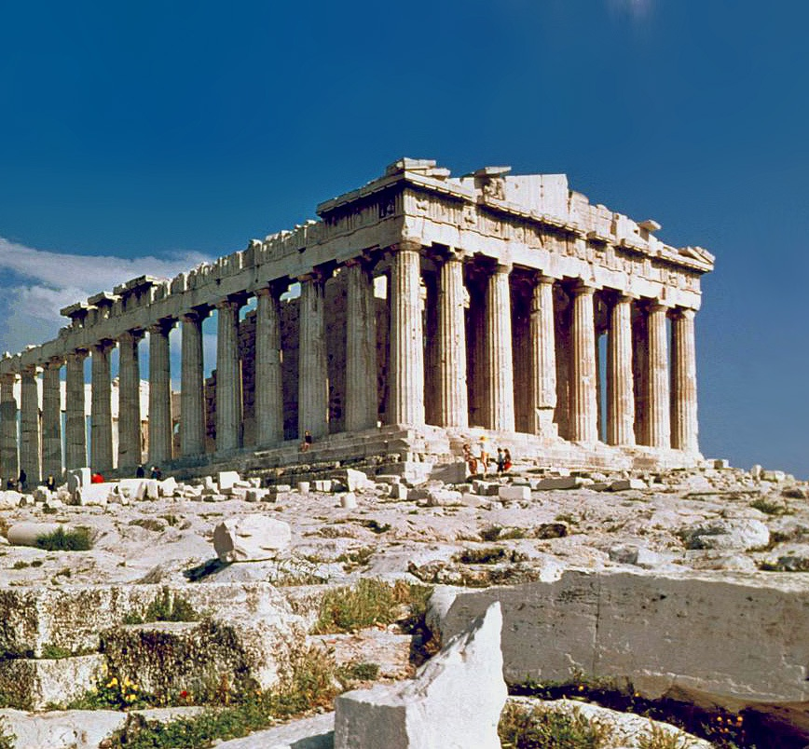
The Parthenon, built on the Acropolis in Athens

Slide 9
Ancient Rome
C. 753 BCE – 476 CE
1300 years
Rome, Italy
Conquered Egyptians, Greeks, and others
Monarchy, republic, and empire
Strong military and advanced culture

Slide 10
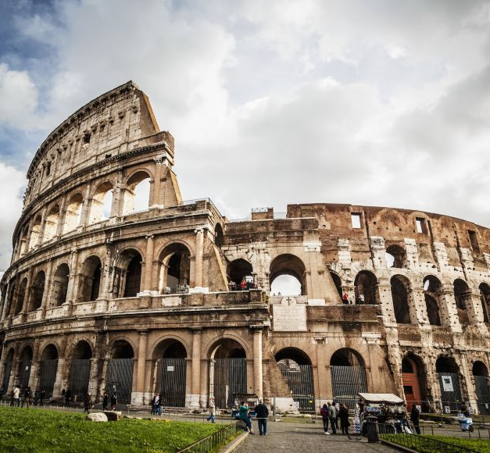
The Colosseum, a vast public stadium, opened in Rome in 80CE

Slide 11
Ancient Egypt
C. 3100 – 30 BCE
Nile River, North Africa
One of the world’s first civilisations
Ruled under one govt from about 3100 BCE
3100-30BCE (when last pharaoh died), there were 31 dynasties and 70 pharaohs

Slide 12
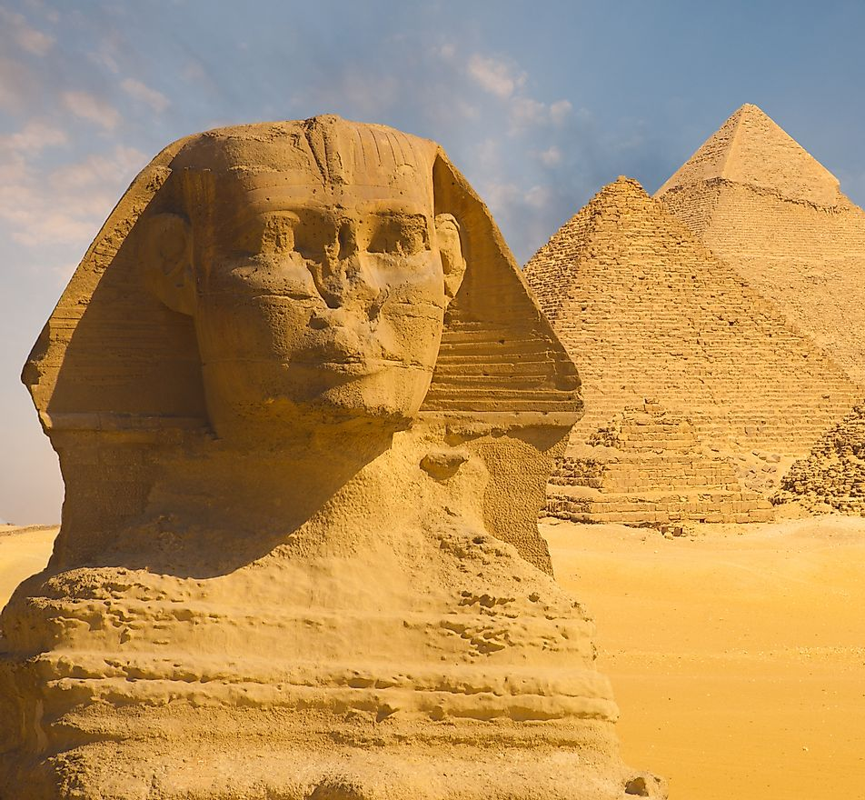
The Great Pyramid and Sphinx at Giza, Near Cairo

Slide 13
Ancient India
C. 3500 BCE – 184 BCE
Indus Valley 3500 BCE
Collection of separate regions and kingdoms – some at war
Ruled by dynasties or empires
MAURYAN EMPIRE – rose and fell in 120 years

Slide 14
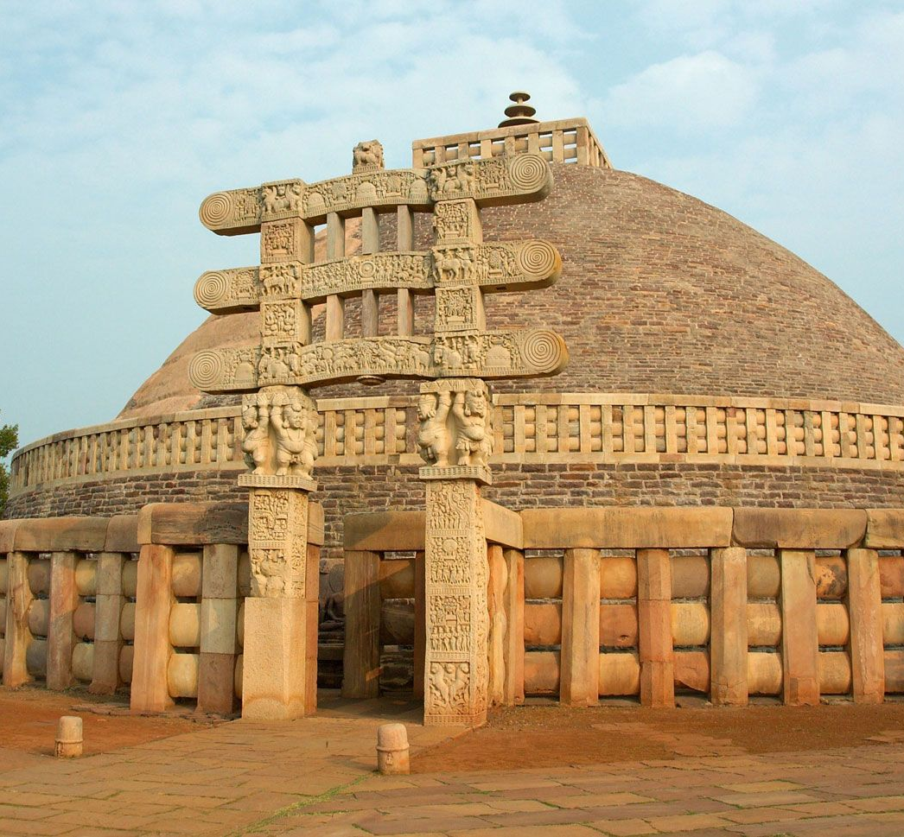
A Buddhist Stupa built during the Mauryan Empire
Notes:
Stupa – most sacred building in Buddhism

Slide 15
Ancient China
C. 1766 BCE – 220 CE
Ruled for 3600 years by dynasties (families)
Last dynasty (Qing) ended in 1912
One of earliest to establish towns and cities
Contributed to important tech developments in the rest of the world (e.g. gunpowder and printing)

Slide 16
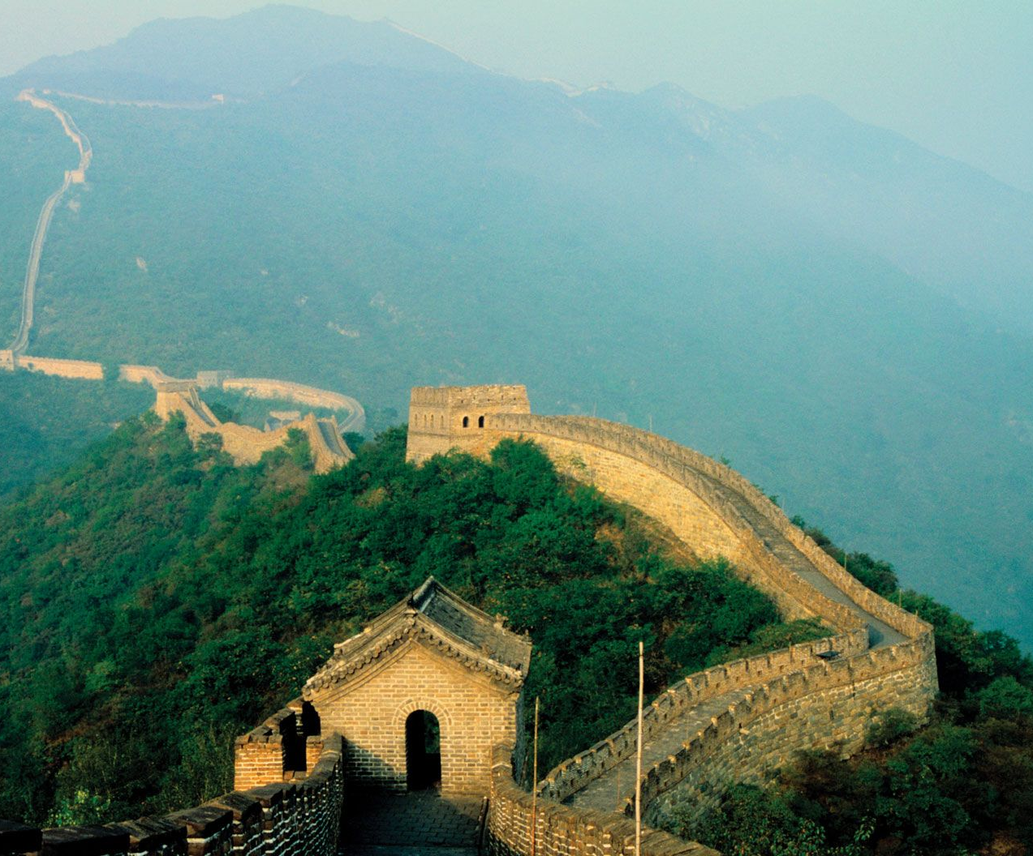
The Great Wall of China

Slide 17
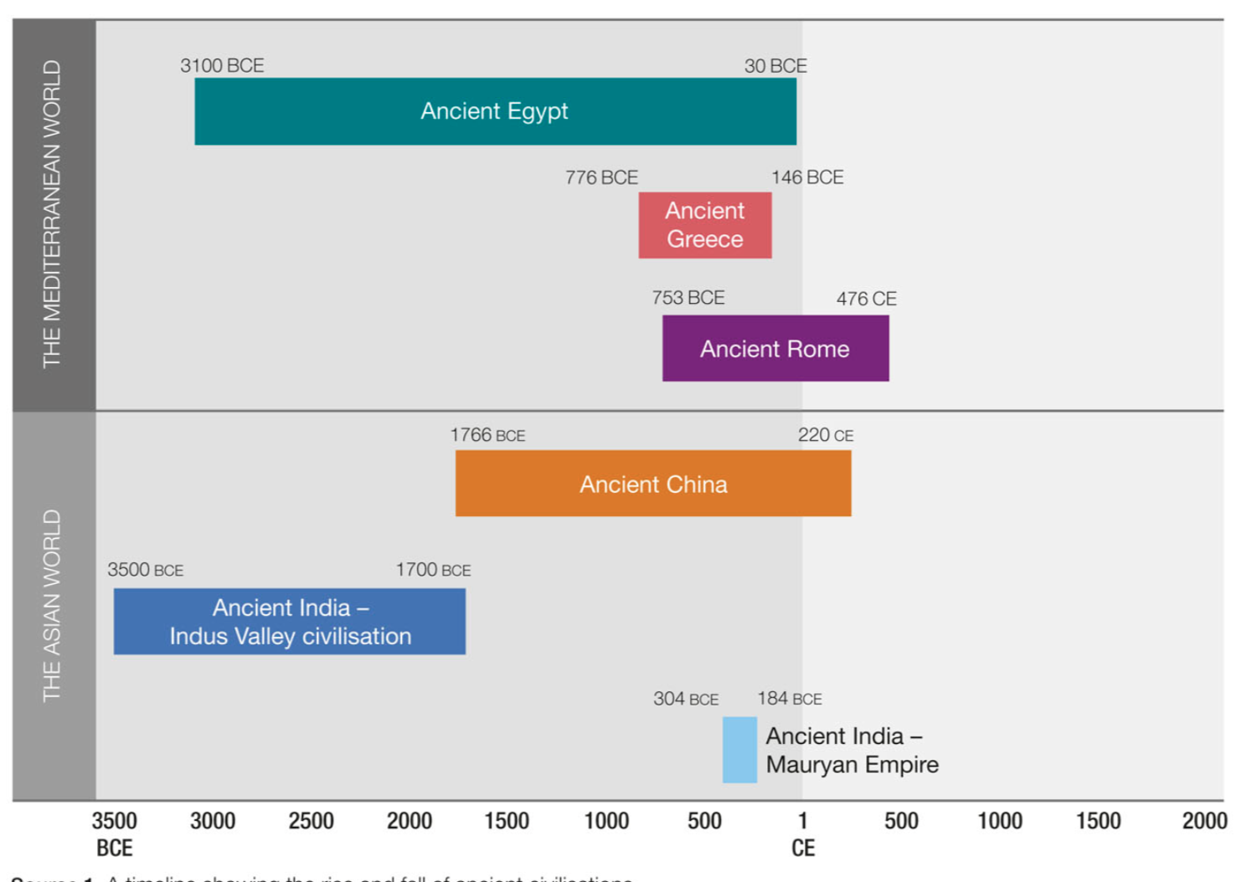

Slide 18
These are not the only ancient civilisations!
Note:
Notes:
Ancient Australia, Mesopotamia etc.

Slide 19

Discussion Question
How do historians investigate the past?

Slide 20
Investigating the past
Historians try to examine the past by examining its remains – fossils, bones, ruins – known as sources.
We use these sources to generate theories (hypotheses) about people and events.
The process involves finding sources, asking questions, and then creating hypotheses – to be proven, there must be evidence.
We must analyse bias of these sources and use

Slide 21
ACTIVITY – Investigating Sources
Get into PARTNERS or work ALONE
Get ONE (1) worksheet
Go to each ‘Dig Site’ based on a different civilization.
Fill out the worksheet columns 1 (Physical Description) and 2 (What we think it was used for).
We will go through the answers at the end.

Slide 22
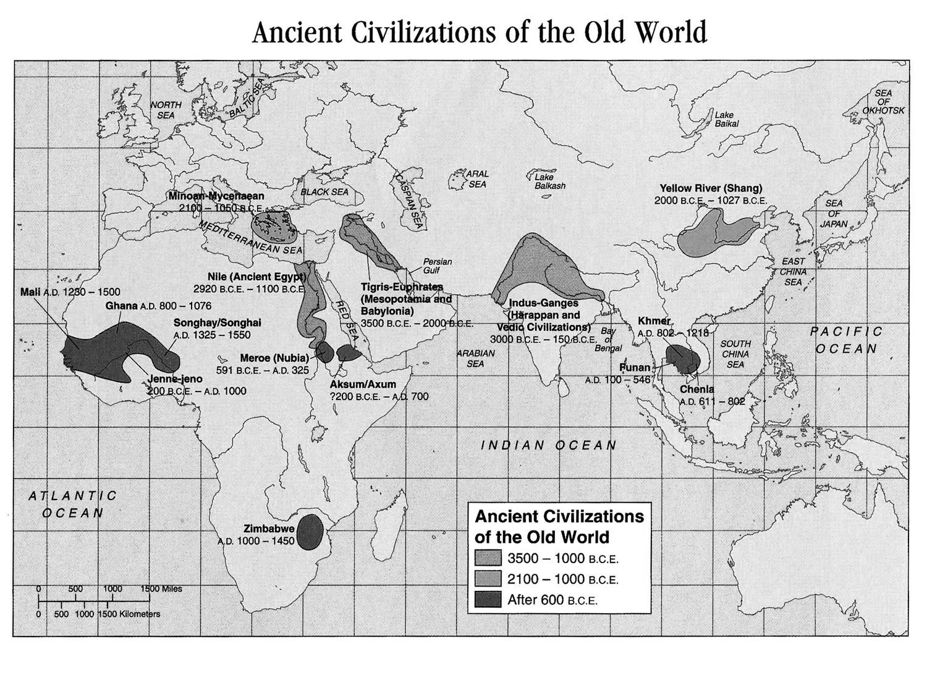
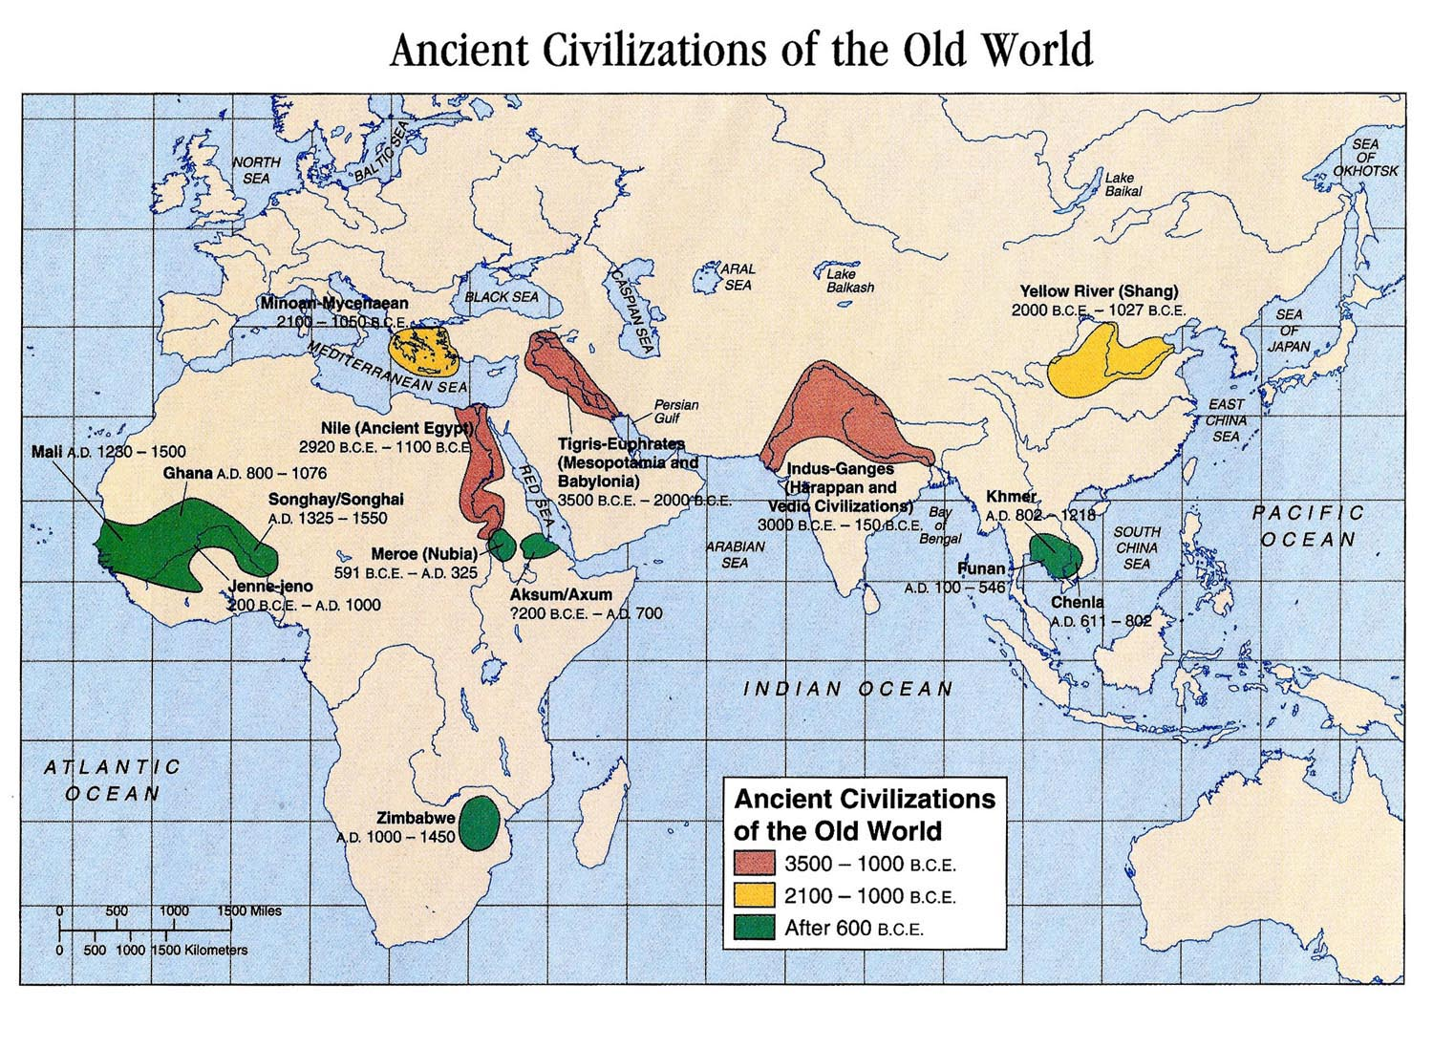
Dig Site: Ancient Mesopotamia

Slide 23
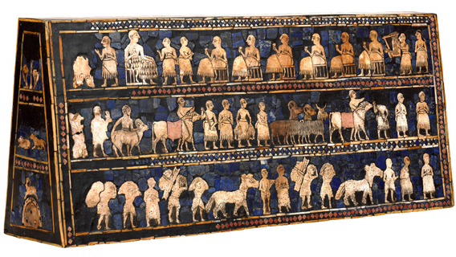
Artefact 1 - Mesopotamia
Artefact 1—the Standard of Ur
The Standard of Ur (a standard is a sort of flag carried in battle)
The main panels are known as 'War' and 'Peace'.
'War' shows one of the earliest representations of a Sumerian army. Chariots, each pulled by four donkeys, trample enemies; foot soldiers with cloaks carry spears; enemy soldiers are killed with axes, others are paraded naked and presented to the king who holds a spear.
The 'Peace' panel depicts animals, fish and other goods brought in procession to a banquet. Seated figures, wearing drink to the accompaniment of a musician playing a stringed instrument.

Slide 24
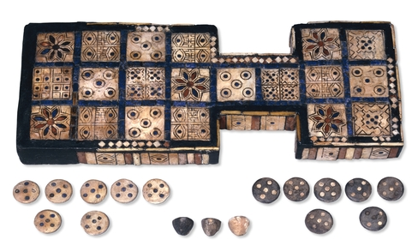
Artefact 2 - Mesopotamia
Artefact 2—the Royal Game of Ur
The board has twenty squares made of shell: Five squares each have flower rosettes, 'eyes', and circled dots. The remaining five squares have various designs of five dots.
According to references in ancient documents, two players competed to race their pieces from one end of the board to another. Pieces were allowed on to the board at the beginning only with specific throws of the dice. We also know that rosette spaces were lucky.

Slide 25
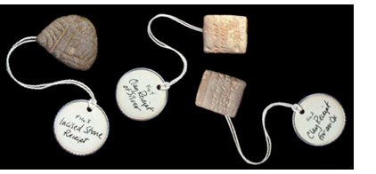
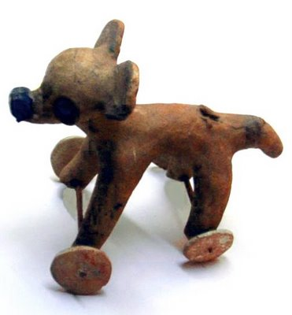
Artefact 3 - Mesopotamia
Artefact 3—Children’s Toy
Both action and domestic toys have been found. Some, like today´s toy guns, were miniaturized weapons of the time; these included sling shots, bows and arrows, and boomerangs and throw sticks.
Other action toys and games included the spinning top, rattles and jump ropes

Slide 26
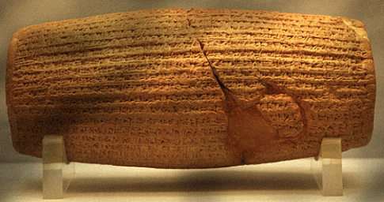
Artefact 4 - Mesopotamia
Artefact 4—Cyrus Charter of Human Rights Cylinder Seal
A cylinder seal was a cylinder engraved with letters, used in ancient times to roll an impression onto a wet clay tablet. They were used as tool to make multiple impressions of clay documents.
This cylinder describes how Cyrus the Great conquered the old city of Babylon and how his mighty army in peacefully entered the city.
Passages in the text of cylinder have been interpreted as expressing Cyrus’ respect for humanity, and as promoting a form of religious tolerance and freedom.

Slide 27
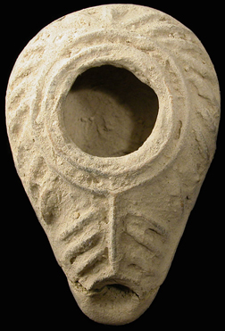
Artefact 5 - Mesopotamia
Artefact 5—Israeli Oil Lamp
In ancient Judaea, tiny oil lamps like this one lit the homes of the common folk. Each home might have dozens of these lamps to provide light for the family who lived there. After lying buried in the soil for 2000 years, this lamp still works and can be lit by filling it with flammable oil and a wick.

Slide 28
Dig Site: Ancient India

Slide 29
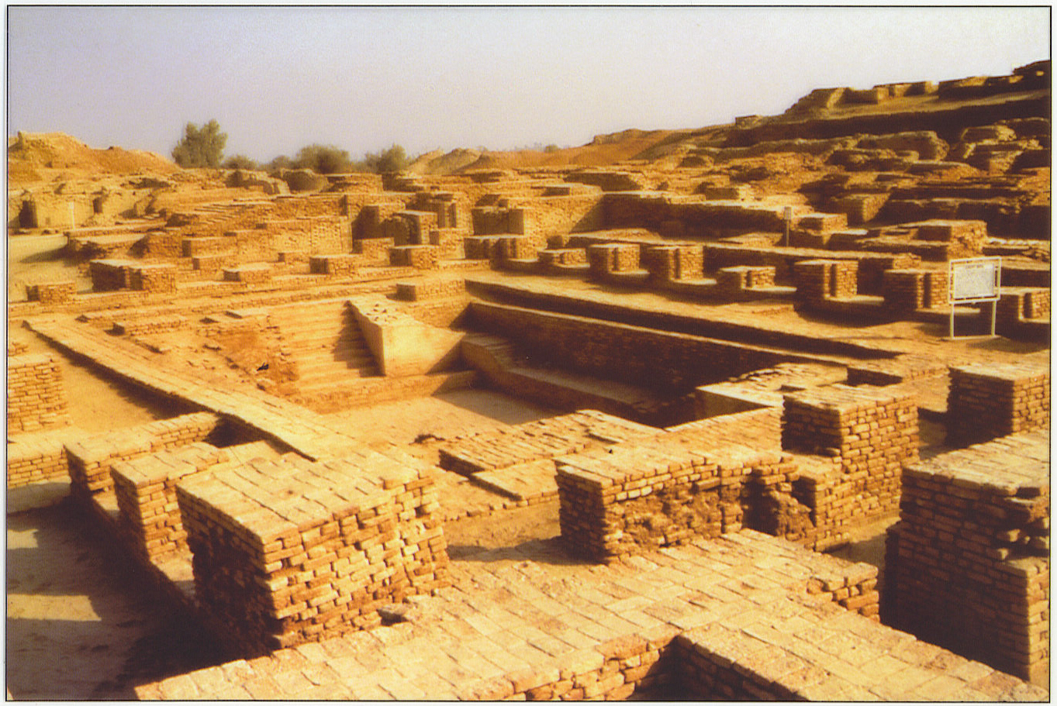
Artefact 6 - India
Artefact 6--Great Bath at Mohenjodaro
One of the earliest cities to flourish along the Indus River was Mohenjodaro. One of the most dramatic features of Mohenjodaro was the Great Bath, which was a pool built of waterproofed brick. It was 39 feet long and 8 feet deep. Small dressing rooms circled the pool. One of the rooms contained a well that supplied the bath with water. Dirty water was removed through a drain that ran along one side of the bath.

Slide 30
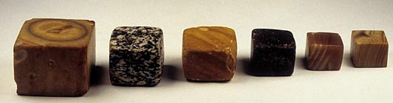
Artefact 7 - India
Artefact 7—Harappan Weights
The other main city of the earliest Indus River Valley civilization was Harappa, where these cubical weights in graduated sizes were found.
These weights conform to the standard weight system that was used in all of the Indus Valley settlements.
They may have been used for controlling trade and possibly for collecting taxes.

Slide 31
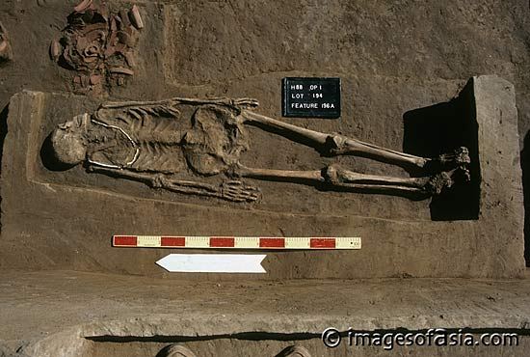
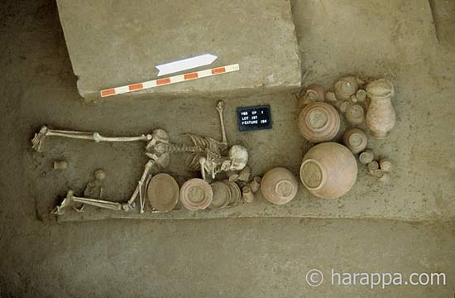
Artefact 8 - India
Artifact 8—Harappan Graves
The body in the top picture is that of a man. He may have been wrapped in a shroud, and was then placed inside a wooden coffin, which was entombed in a rectangular pit surrounded with burial offerings in pottery vessels.
In the grave shown in the bottom picture are the bodies of a mother and child. This burial was disturbed in antiquity, possibly by grave robbers. Archaeologists have determined this because the body is flipped, the pottery is disturbed, the woman’s arm is broken, and the bracelets that would normally be found on the left arm are missing. The infant was buried in a small pit beneath the legs of the mother.

Slide 32
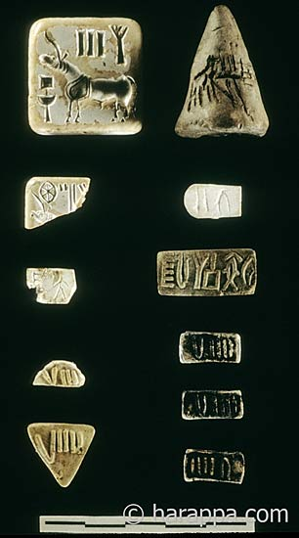
Artefact 9 - India
Artefact 9—Collection of Stamps and Tablets
This picture shows collection of stamps and tablets from a single house along the main street leading to the southern gateway of Mound E at Harappa. The association of these different types of objects together in one house show that some people, possibly merchants, were using a wide variety of inscribed objects.

Slide 33
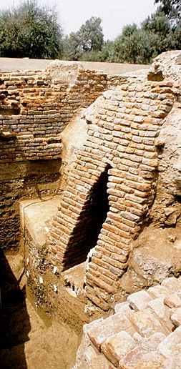
Artefact 10 - India
Artefact 10—Harappan Drain
This Harappan drain was part of the extensive sewage system that existed in the city. Drainage systems were located in every street. At the end of each drain was a wooden screen. Wastewater would pass through the screen and enter brick-lined cesspools or be tunneled to the local river for discharge.
Homes had both rooms for bathing and latrines that were connected to sewers in streets.

Slide 34
Dig Site: Ancient China

Slide 35
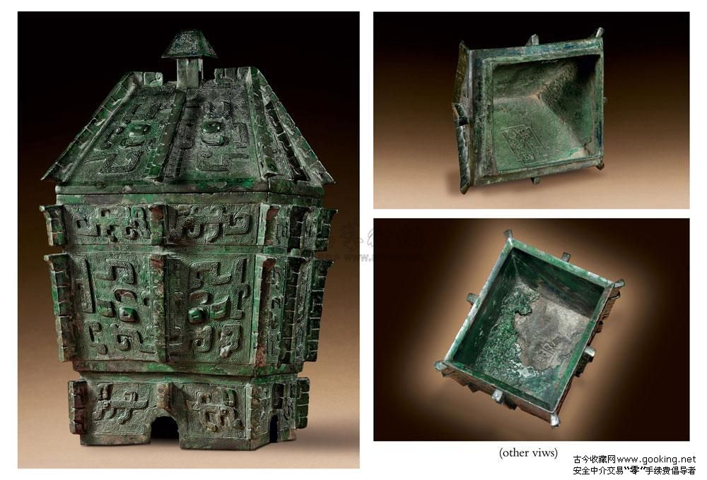
Artefact 11 - China
Artefact 11—Bronze Wine Container
Some of the oldest works of art from China are bronze containers. These containers included cooking pots, wine jars and water vessels that were used to offer food and drink to gods in ceremonies and rituals.
Bronze containers symbolized rank and often contained references to ancient culture and music.
Bronze containers and figures were generally made by making a wax cast of the item, then pouring in the molten metal.

Slide 36
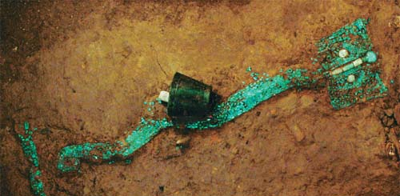
Artefact 12 - China
Artefact 12—Dragon-shaped Grave Ornament
This grave ornament was excavated from a tomb of a high-ranking noble in the palace area of Erlitou. The turquoise dragon was found between the shoulder and the hipbone of the owner of the tomb. The dragon ornament, 70.2 cm long, is made up of more than 2,000 pieces of turquoise.
The owner of the tomb must have been put in an important position by the king of the Xia Dynasty, since he was buried in the palace area and allowed to take the ceremonial club to the other world after he died.

Slide 37
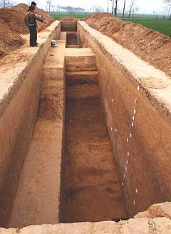
Artefact 13 - China
Artefact 13—City Walls and Moat at Erlitou
A city wall and moats enclosed Erlitou, the city that many archaeologists believe was the capital of the Xia Dynasty. The two moats from the Xia time period ran parallel to each other.
"The remains of the city wall were composed of several different layers of earth, showing that the wall had been renewed or restored again and again in antiquity," said team leader, Wang Wenhua.
Remains of foundations, tombs, ash pits and ash ditches together with many other relics were discovered inside the city site.

Slide 38
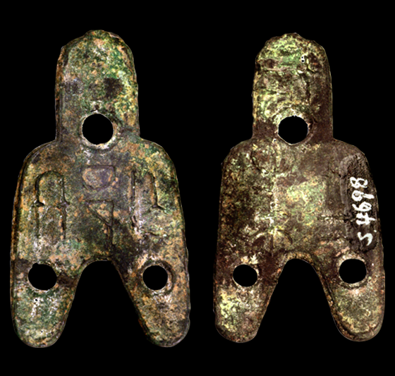
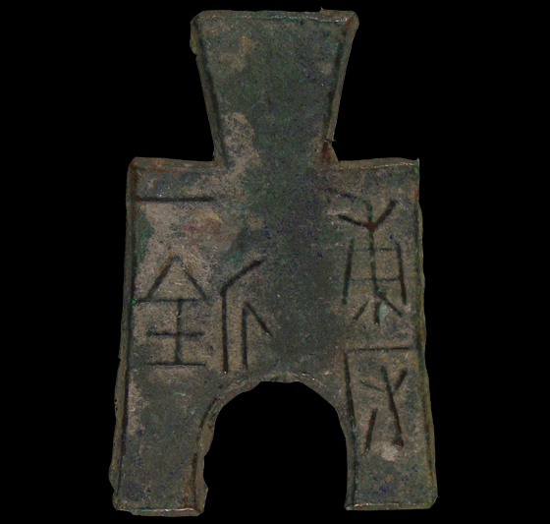
Artefact 14 - China
Artefact 14—Coins from Zhou Dynasty
More than one hundred thousand coins, as well as the molds used to make them were unearthed from the remains of a workshop at Luoyang, a city from the Zhou period.
During the Warring States period (Zhou Dynasty) coins became common. Appropriately, almost all of the coins were shaped like spades, knives, or clubs.
In this way, a new type of currency exchange system was fully established. The fact that so many coins were being minted during the Zhou period shows that a money economy (rather than a barter economy based on direct trade) was beginning to develop.

Slide 39
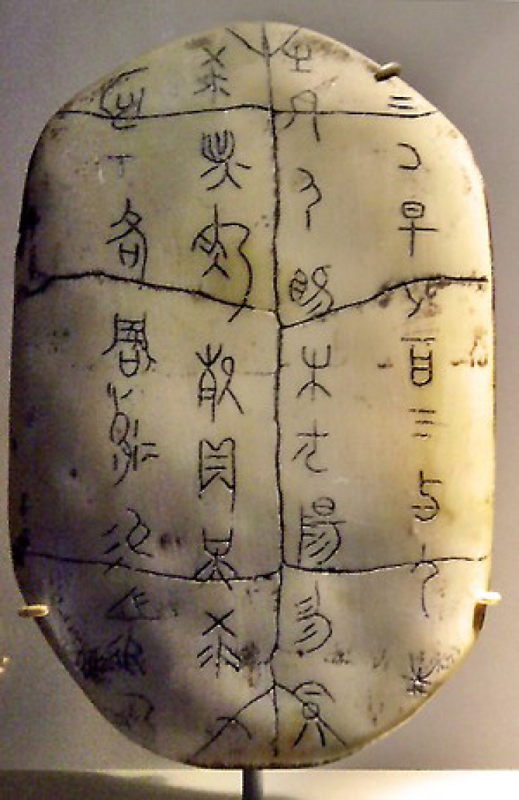
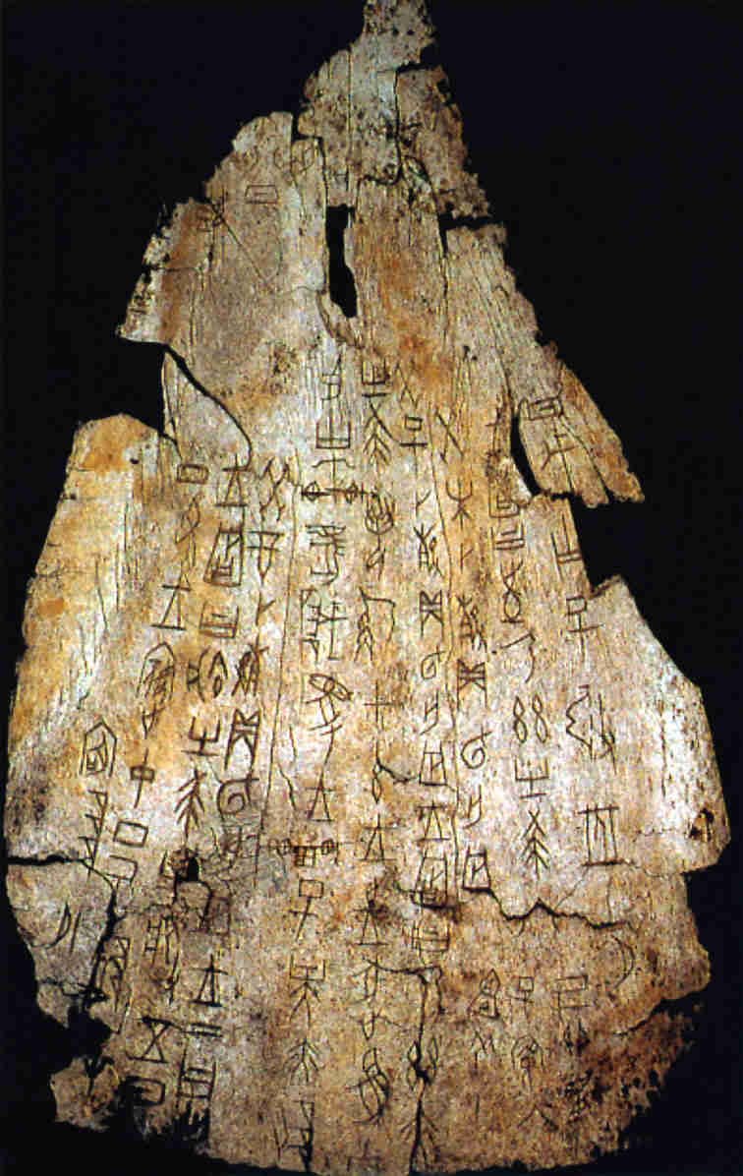
Artefact 15 - China
Artefact 15—Oracle Bones
Oracle bones are a type of artifact found in archaeological sites from the Shang Dynasty in China. The site of Anyang had over 10,000 of these objects, primarily ox shoulder blades and turtle shells carved with archaic forms of Chinese characters.
Oracle bones were used to practice of a form of divination, or fortune-telling. Seers told the future based on the cracks in an animal bone or turtle shell after they had been heated in a fire. The cracks were then used to determine the future.

Slide 40
Dig Site: Ancient Egypt

Slide 41
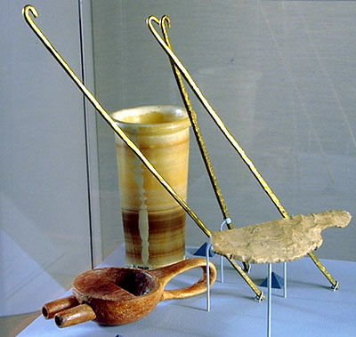
Artefact 16 - Egypt
Artefact 16 - Mummification tools
(brain hooks, oil jar, funnel, and embalmer’s knife)
Egyptians believed that all people had souls, which they referred to as ‘ka.’ The ka was a person's double, sort of an invisible twin, which supposedly lived in the body until death. It was necessary to prevent the dead body from decaying because the ka still needed it! This is why the Egyptians wanted to preserve the dead in as life-like a state as possible. Mummification was the guarantee of eternal life.
After being delivered to the embalming place, the deceased was placed upon a slanted table. The first task that needed to be done was to remove the soft, moist body parts that would cause decay. As these parts were removed, blood and other bodily fluids trickled out and flowed down the table into a collecting bowl.
The first part to be removed from a mummy was the brain. The bone that separates the nasal cavity from the brain cavity was broken open by ramming a sharp instrument up the nose. Then, a long hook was used to stir up the brain until it was liquefied. By turning the body face down, the brain would spill out the nostrils. The Egyptians were so rough on the brain because they didn't realize its importance. They thought its purpose was just to produce snot!

Slide 42
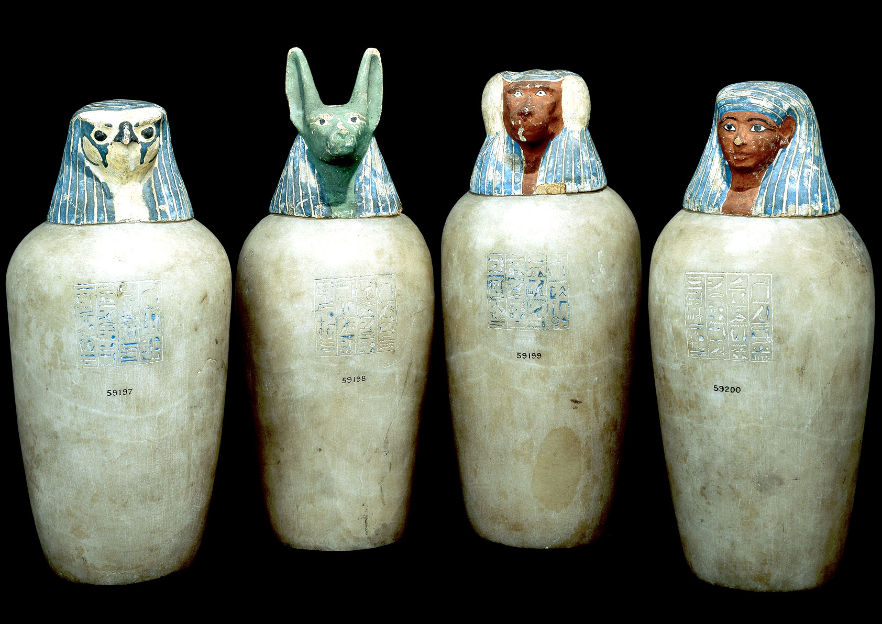
Artefact 17 - Egypt
Artefact 17—Canopic Jars
After the brains had been removed from the potential mummy, the next step was to remove some of the major organs. One of the embalmers would use a blade made of sharpened stone to make an incision in the left side of the abdomen.
The stomach, intestines, liver, and lungs were removed and preserved by drying them in a special salt called natron. After drying, each of the organs would be put in a canopic jar. The stoppers of canopic jars were shaped like the heads of the four sons of the god Horus. Each son protected the organ placed inside his respective jar. These jars would be placed inside the tomb upon the burial of the mummy.

Slide 43
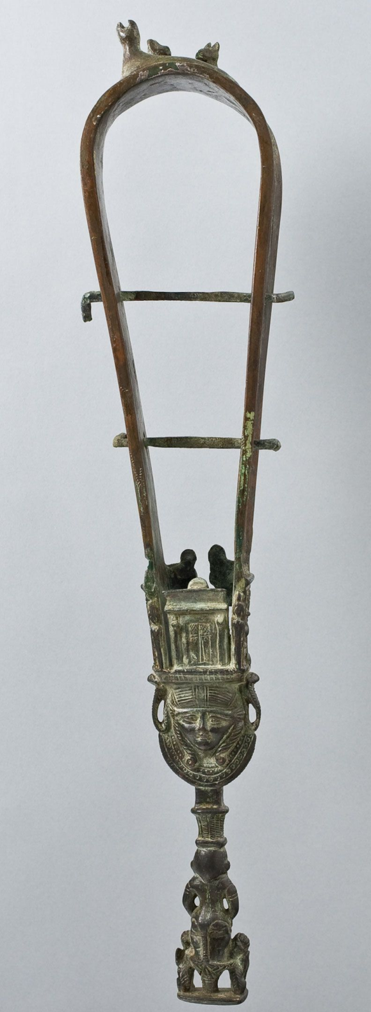
Artefact 18 - Egypt
Artefact 18—Sistrum
A sistrum was basically a rattle made up of an arch with a handle attached. The arch had a number of cross pieces onto which were threaded metal discs. When the sistrum was shaken, the discs rattled. The top of the handle was often decorated with the head of the god of music, Hathor.
The sistrum was used in Egyptian festivals and was often played by temple songstresses. It was believed that the sound of rattling also drove off malign forces, preventing them from spoiling the festival.

Slide 44
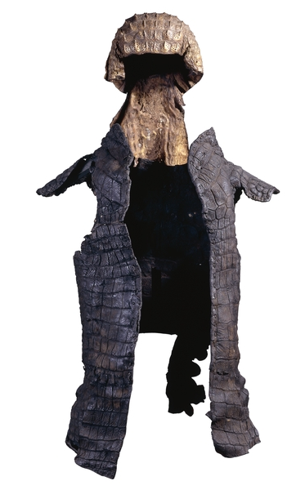
Artefact 19 - Egypt
Artefact 19—Crocodile Skin Armor and Helmet
In ancient Egypt the crocodile was seen as sacred and divine, and worshipped as a god, so this suit might have been worn by priests of the crocodile sect who by wearing such a garment would take on the spirit of the deity.
In many parts of Africa the crocodile is seen as a fearsome and invincible creature and so, by wearing crocodile armor and a headpiece like this, a warrior might be transformed in some magical way and take on the attributes of the animal.
This imposing armor is made from the skin of a crocodile. It is made up of a helmet and cuirass (body armor) and would have been used in military-style ceremonies of the regional crocodile cult.

Slide 45
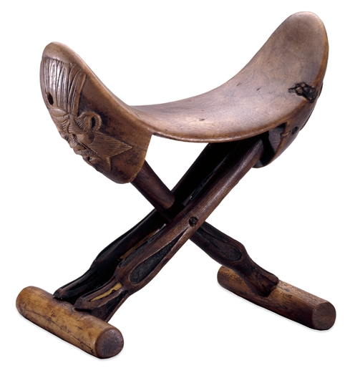
Artefact 20 - Egypt
Artefact 20—Egyptian ‘Pillow’
This folding headrest is modeled on the folding stools that were popular among the wealthy of the time. Egyptians would have used this headrest in much the same way that modern people use soft pillows.
On this headrest, heads of the god Bes are carved onto the neckpiece. Night was a time when people felt that they were vulnerable to evil forces; demons could cause illness and nightmares, attacking while the unsuspecting person slept. Figures or heads of Bes were sometimes placed on headrests to ward off these chaotic forces.

